Slide 1
How we use Microsoft Flow & PowerApps: Real Case Scenarios
Sandro Pereira
Microsoft Azure MVP

Slide 2

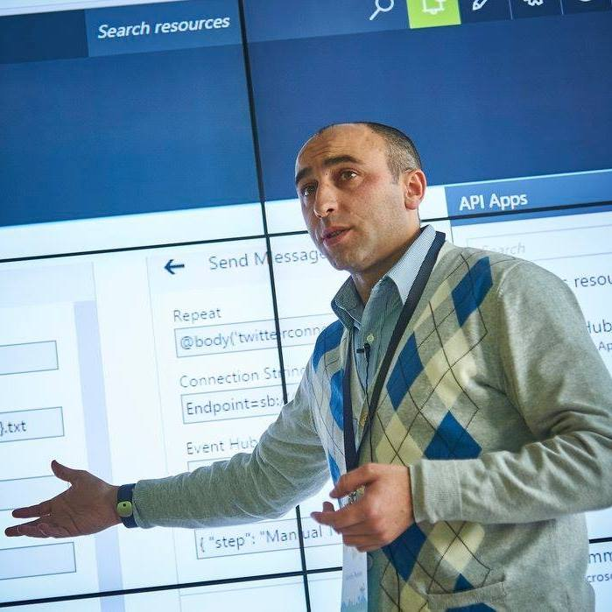


Who am I?
Integration Codeless Wizard
Microsoft Azure MVP
sandro.pereira@devscope.net
linkedin.com/in/sandropereira
@sandro_asp
https://blog.sandro-pereira.com/
Public speaker
Book author: “BizTalk Mapping Patterns and Best Practices”
Sandro Pereira
+351 223 751 350
www.devscope.net
Notes:
Interested in all things integration – which of course includes MS Flow

Slide 3
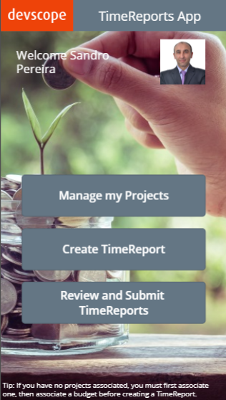
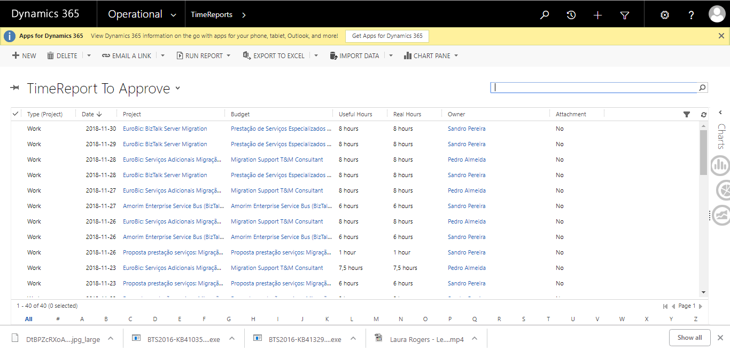
Scenario #1 – Time Reports App
Microsoft Flow
API Management
Web API
Azure SQL Database
ON PREM

Slide 4

Scenario #2 – SmartDocumentor Expenses
Microsoft Flow
Azure SQL Database
ON PREM
API Management
Web API

Slide 5

Scenario #3 – CSI Feedback
Microsoft Flow

Slide 6
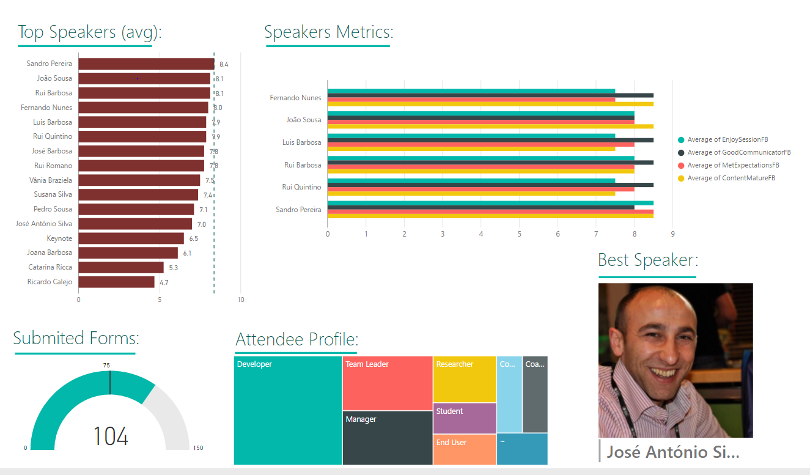
Scenario #4 – SmartDocumentor Evaluation Forms (Paper)
KPI’s
Event Attendees
Microsoft
Flow
Azure
Functions
Power BI

Slide 7





Thanks!
Sandro Pereira
Integration Codeless Wizard | Microsoft Azure & Visio MVP
sandro.pereira@devscope.net
linkedin.com/in/sandropereira
@sandro_asp
https://blog.sandro-pereira.com/
+351 223 751 350
www.devscope.net

